Slide 1

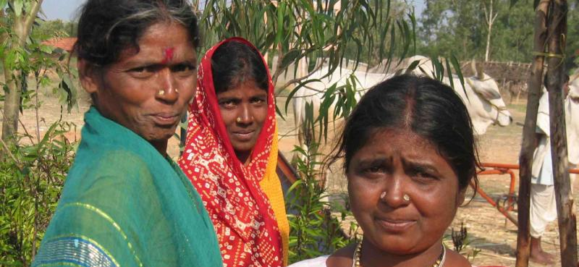
Research on
Women & Usability of Mobile Financial Services in India

Slide 2
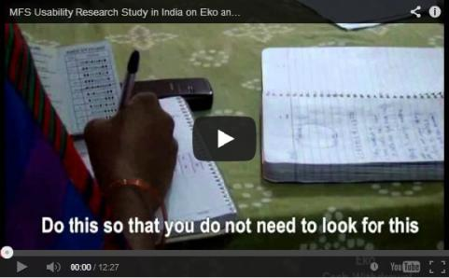
Contents
Introduction……………………...….…..3
Summary of Findings……….………..6
Key Factors……………...….....….7
Recommendations…...………….….26
For an additional view of our study, please see our video of participant responses.

Slide 3
Introduction
The goal of this research is to understand how mobile phone technology and its usability is impacting poor women’s ability to access and benefit from mobile financial services. Many players assume that if a poor person owns a mobile phone, they are able to use it. We believe that this is a faulty assumption, and believe that usability and “mobile phone literacy” are big issues that prevent poor women in particular from benefitting from mobile-enabled solutions. This study expands on the ‘Women, Mobile Phones and Savings’ case study Grameen Foundation completed a year ago in India, which studied a 65-person sample size.
Our intention is to demonstrate the specific challenges and constraints that women in particular face while using a mobile delivery channel for financial services. These findings will be used to influence commercial players (mobile money operators, banks, technology service providers, agent network managers) as well as back-end technology and hardware designers to address usability issues that are preventing poor women from benefitting from mobile financial services.

Slide 4
Introduction
Location
In India, CKS conducted research in rural areas around the district of Jaunpur in Eastern Uttar Pradesh, an area where all three of the mobile financial services we targeted (Eko, Airtel Money and Vodafone M-Pesa) are available.

Slide 5
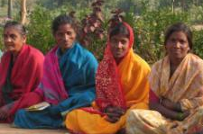
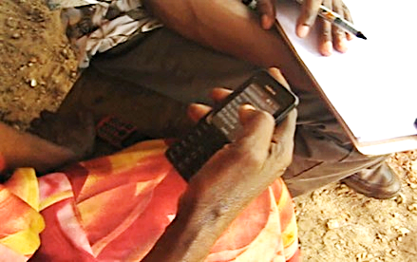
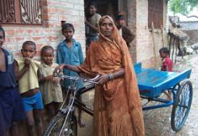
Introduction
Methods
We conducted qualitative research using a variety of methods:
Contextual Interviews
We interviewed 15 people including current customers, potential customers and mobile financial services agents.
Facilitated Usability Sessions
We facilitated discovery and task based usability sessions with 12 current and potential users on the interfaces including 8 women and 4 men.
Observation
We observed 3 mobile service agent centers.

Slide 6
Summary of Findings
Rural women are stuck at home tending to domestic duties and remain unaware of services available to them.
Many women do not own or have access to phones. Those that do, have low comfort with using them.
For women, assisted transactions are here to stay (at least for a generation) and there is no incentive to become an independent user.
Women outsource, often sending their children and husbands to the agent to transact for them.
The user-interfaces use confusing terminology and are not offered in local dialects.
These services require up to 16 steps to complete simple functions such as balance check. This causes confusion, errors and frustration.

Slide 7
Key Factors
Our research uncovered the following observations and insights that impact poor, rural women’s ability to access and benefit from mobile financial services:
1. Awareness
Many poor, rural residents remain unaware of the mobile financial services available to them – especially women who are stuck at home tending to domestic duties.
2. Accessibility
Poor women often lack access to a phone or do not own one. The cost of opening a mobile money account often prohibits customers from accessing mobile financial services. Network strength can also be problematic.
3. Comprehension, Comfort & Confidence
These 3C’s are major factors in women’s usage of mobile phones and MFS. Women are challenged by mobile literacy, MFS language, terminology and literacy. Often, a trusted intermediary assists women with transactions.
4. Usage
Navigating through the user interfaces and menus is very difficult. Some services require up to 16 steps to complete simple functions such as balance check. Other services require users to enter long strings of numbers and characters which causes confusion, errors and frustration.

Slide 8
1. Awareness
Many poor, rural residents remain unaware of the mobile financial services available to them – especially women who are stuck at home tending to domestic duties.

Slide 9
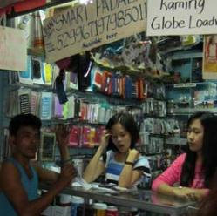
1. Awareness
Service Awareness
One of the three services we researched are effectively marketing and promoting their services while the other two services are using channels that do not reach the rural poor, especially women.
Eko is currently being adopted by the poor women we interviewed. Our participants became aware of this service via Cashpor, a microfinance institution that promotes its service in the weekly meetings in the village locations.
On the other hand, Vodafone M-Pesa and Airtel Money promote their service through vans that travel through main markets located on highways. But the poor women do not frequently visit these areas so they lack awareness about these mobile financial services.

Slide 10
1. Awareness
We interviewed three agents, one from each of the three MFS’s to get a sense for how they promote their services and their awareness of specific features within these services.
EKO
Even though the Cashpor agent knows that the balance check feature could be performed independently, he does not inform his customers of this unless they inquire about it. Additionally, he is not aware that his customers can initiate cash withdrawal through their phones. He explains to potential customers that they can start saving small amounts, such as $ 0.32 (INR 20) per week, in order to save $ 1.60 (INR 100) per month and $ 9.63 (INR 600) in 6 months. As a result, some women, particularly in the age 26-32 cohort, are adopting the service because they have 3-4 children attending school and feel greater need to save to meet their education related needs.
Vodafone M-Pesa
This service was introduced in mid-2013 in the Jaunpur region. The M-Pesa agent is currently promoting this service only to his regular, existing customers of Vodafone mobile service, who have a daily household income of $4 and above.
Airtel Money
The Airtel Money agent services a no-frills savings account of Axis Bank which allows a customer to save money. Yet, he is not aware that the Airtel Money can also be used as a savings vehicle. He is currently promoting Airtel Money through the mobile and DTH recharge (digital TV account) features as they are popular among many young men from households with daily income of $4 and above. Potential female customers are not reached by this promotion method. They rely on their husbands and children to transact for them.

Slide 11
2. Accessibility
Poor women often lack access to a phone or do not own one. The cost of opening a mobile money account often prohibits customers from accessing mobile financial services. Network strength can also be problematic.

Slide 12
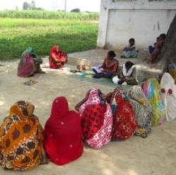
2. Accessibility
Phone Ownership
Despite increasing mobile penetration in India, roughly 75% in 2013, limited phone access and ownership are barriers for poor women. In almost every household in our survey, there is just one phone that is shared by all family members. Generally, men own the phone and take it to work while women are stuck at home. Women can use the phone when their husbands are home and yet even then, they must share with the whole family. This limited access leads to their discomfort and unfamiliarity with mobile phones.
For most poor women, mobile financial services are not an option as they do not own or have easy access to mobile phones. To address this and motivate women to adopt Eko’s service, the agent we spoke with offers her mobile phone for transactions and asks the women to purchase their own SIM to put in her phone while they use it.

Slide 13
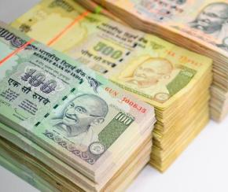
2. Accessibility
Cost
The cost of opening an account often prohibits customers from accessing mobile financial services. Many poor women say they are not able to save enough to open an account. Additionally, there is a lack of knowledge about cost saving features such as unlimited transaction fees.
Each of the service providers charge a fee. Cashpor and Airtel Money charge $2.41 (INR 150) to open an account, out of which $0.80 (INR 50) is the optional cost for unlimited transactions, but most women are not aware of it. Airtel Money also charges $2.41 (INR 150) for opening an account, but it is not optional and the customers have to pay this initial amount. Vodafone M-Pesa charges $3.21 (INR 200) to open an account.
Many of our participants indicated that they cannot afford to pay $2.41 (INR 150) to open an account as they only save $1.6-3.21 (INR 100-200) monthly, which they prefer to keep for emergency situations.
* All currency conversions based on
1 USD = INR 62.31

Slide 14
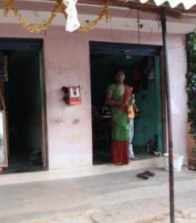
2. Accessibility
Network
Network connectivity is a major issue for mobile financial services. We encountered interruptions in connectivity while testing on all three providers.
Airtel Money is most preferred by customers because of its good network strength, while Vodafone M-Pesa is chosen less often due to poor connectivity. Network strength is a key consideration when choosing a service provider.

Slide 15
3. Comprehension,
Comfort & Confidence
These 3 C’s are major factors in women’s usage of mobile phones and MFS. Women are challenged by mobile literacy, MFS language, terminology and literacy. Often, a trusted intermediary assists women with transactions.

Slide 16
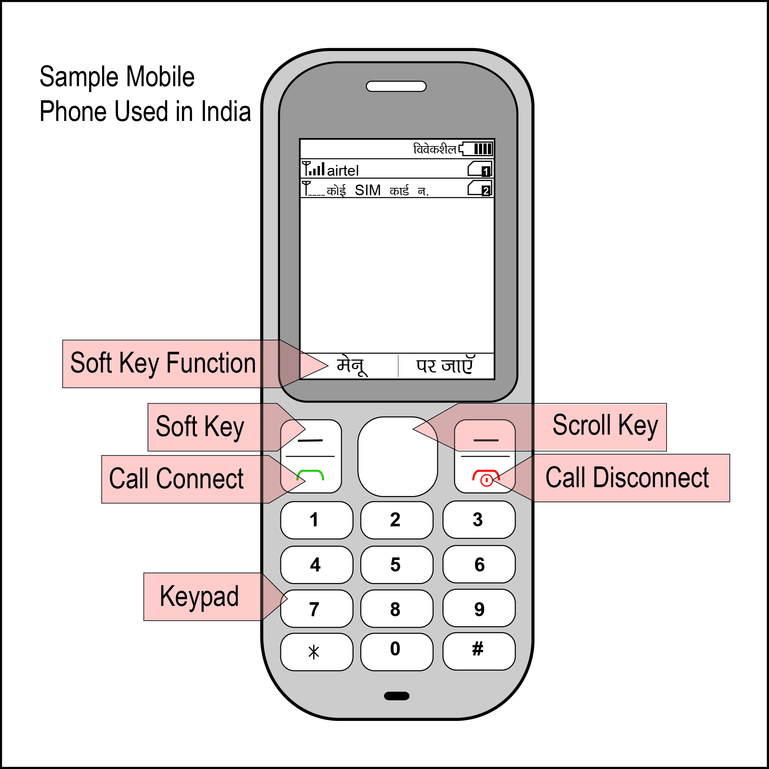
3. Comprehension, Comfort & Confidence
Mobile Literacy
Some of our participants know how to make and receive calls and, for many, this is the extent of their abilities. A few of the women in our study (who are educated) know how to check a message from their inbox.
All of our participants made errors using these services. When confused, many pressed “back” or “call disconnect” because they fear pressing a wrong button and losing money.

Slide 17
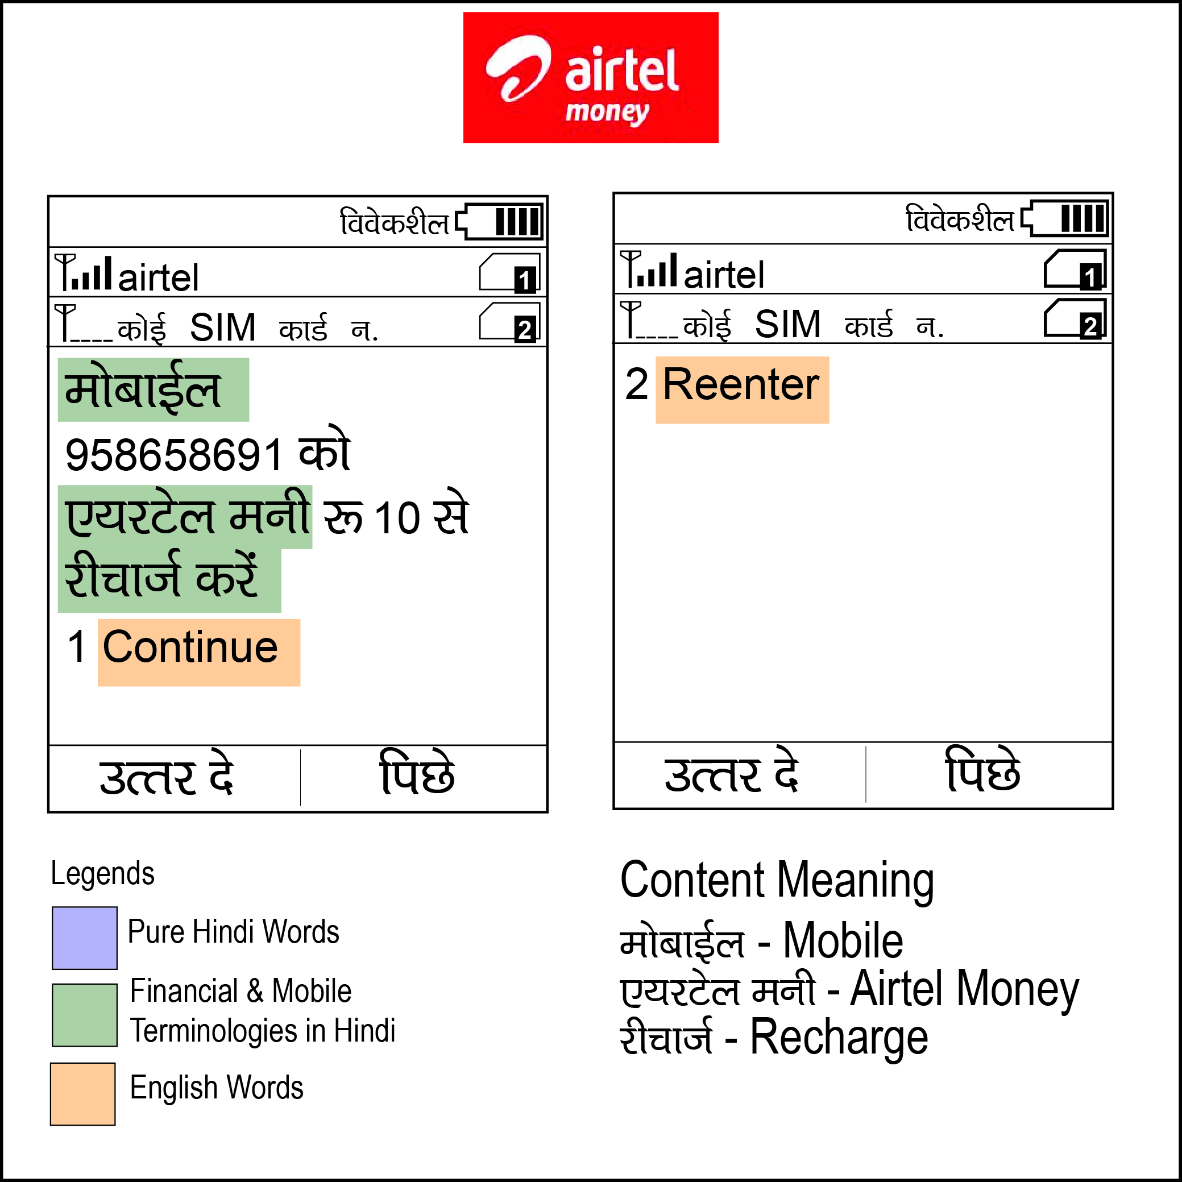
3. Comprehension, Comfort & Confidence
Language
The menus, messages and instruction booklets of all three services are in English or Hindi which none of our participants are able to consistently and easily comprehend. Everyone we interviewed expressed a preference for services to be offered in their local dialect.

Slide 18
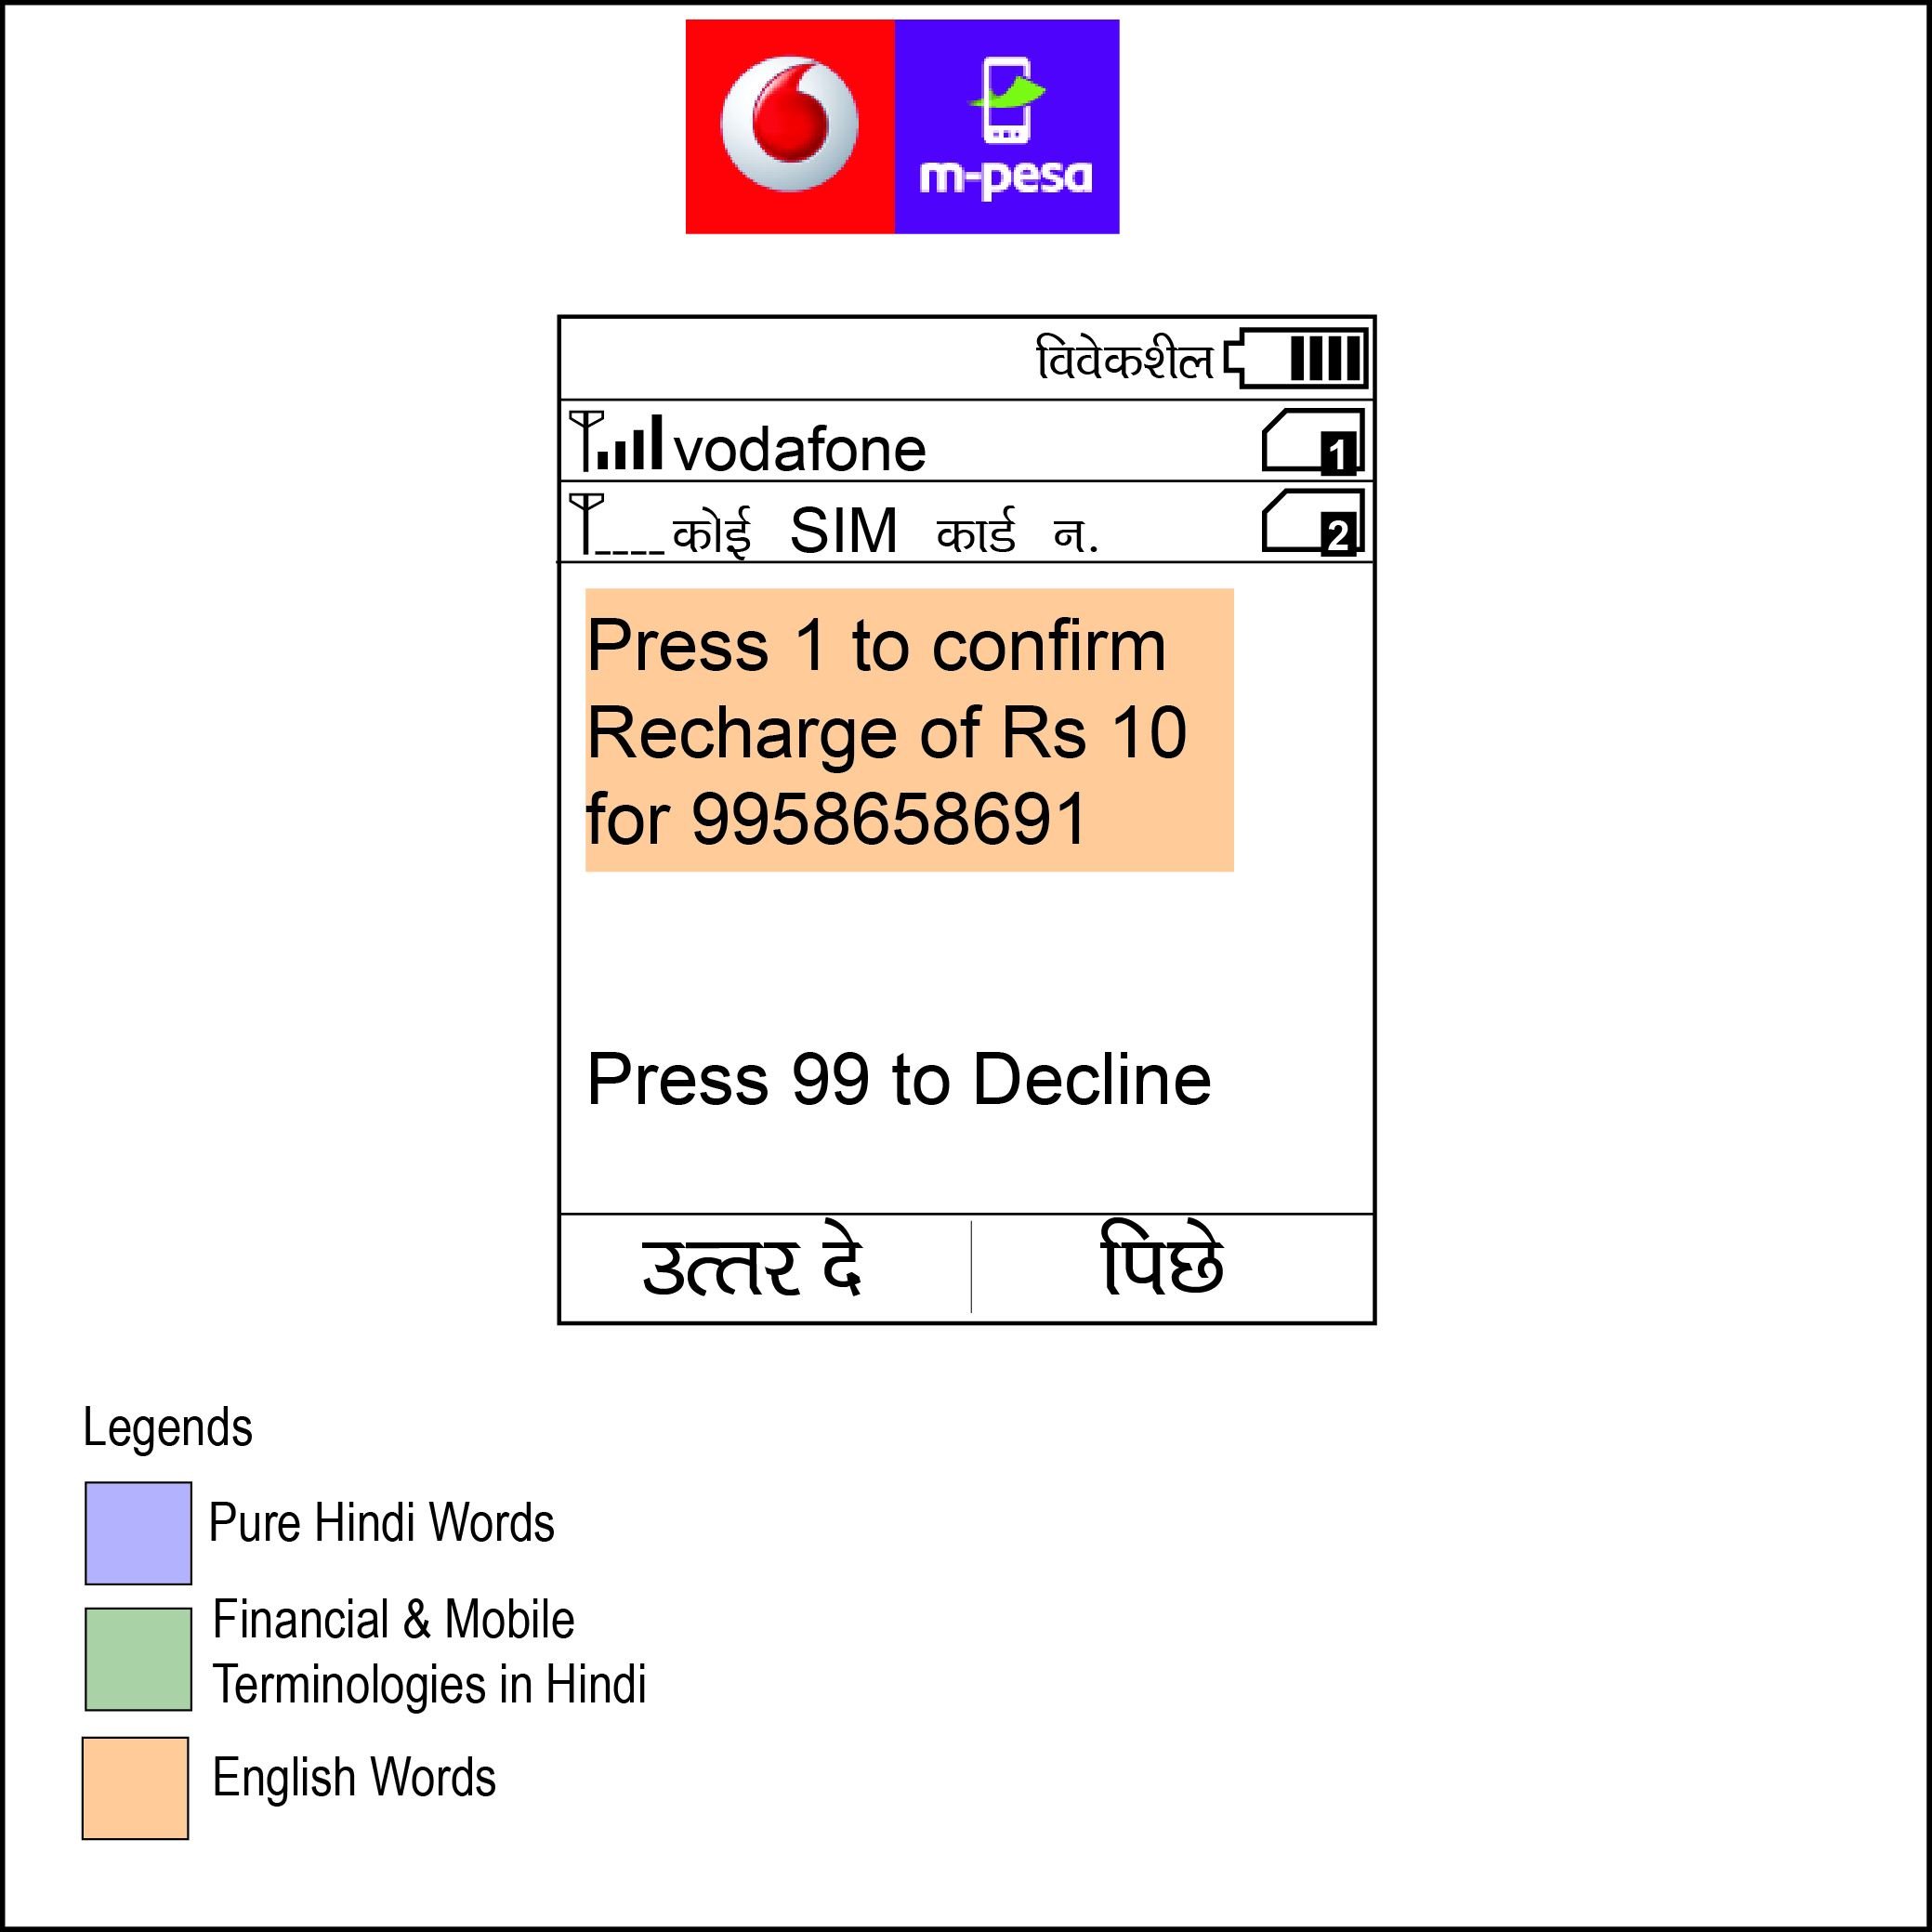
3. Comprehension, Comfort & Confidence
Terminology
All three of the services we studied use confusing mobile and financial terminology that our participants were not able to understand. Here are some examples of these confusing terms:
Eko
Abbreviated terms such as “Bal” and “A/C”
Vodafone
Mobile terms such as “prepaid,” “postpaid” and “recharge”
Airtel Money
Financial terminology “Block Amount” (written in Hindi). Mobile terms such as “prepaid,” “postpaid” and “recharge”

Slide 19
3. Comprehension, Comfort & Confidence
Literacy
Literacy significantly impacts usage. The comfort of using mobile phones varies based on literacy levels. Many cannot read the information displayed on screen and this inability to understand content and language leads to high error rates. Educated women are more comfortable using mobile phones and make fewer errors than illiterate or less educated women.

Slide 20
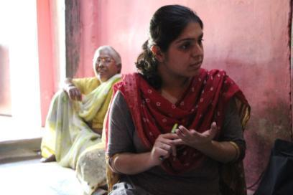
3. Comprehension, Comfort & Confidence
Using a Trusted Intermediary
With agent-based mobile financial services like Eko, Airtel Money and Vodafone M-Pesa, agents are trained and available to help customers make transactions. They can assist with actions such as utility bill payments, phone recharge and money transfers. However rural women do not visit the agent themselves. They rely on their husbands and children who visit the agents to transact on their behalf.

Slide 21
4. Usage
Navigating through the user interfaces and menus is very difficult. Some services require up to 16 steps to complete simple functions such as balance check. Other services require users to enter long strings of numbers and characters which causes confusion, errors and frustration.

Slide 22
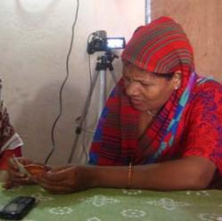
4. Usage
Navigation
Navigating through the user interfaces and menus is very difficult and complex.
Multi-Step: Both Airtel Money and Vodafone M-Pesa require between 12-16 steps to complete simple functions. Most of our participants made several errors while trying to navigate these steps.
Memorization: Many of our participants could not read or comprehend the information on the Airtel Money and Vodafone M-Pesa screens, instead they memorized the steps. However, this leads to errors, especially towards the end of the process, as they only remember the initial steps.
Multiple Attempts: It took 3–4 guided attempts for our participants to successfully navigate Airtel Money and M-Pesa. However, Eko is a one step process and was immediately successful on the first attempt.
PIN: PIN usage is confusing. All of our participants understood the illustrated instructions in the Eko booklet but could not understand how to use the 6-digit OkeKey number and 4-digit PIN.

Slide 23
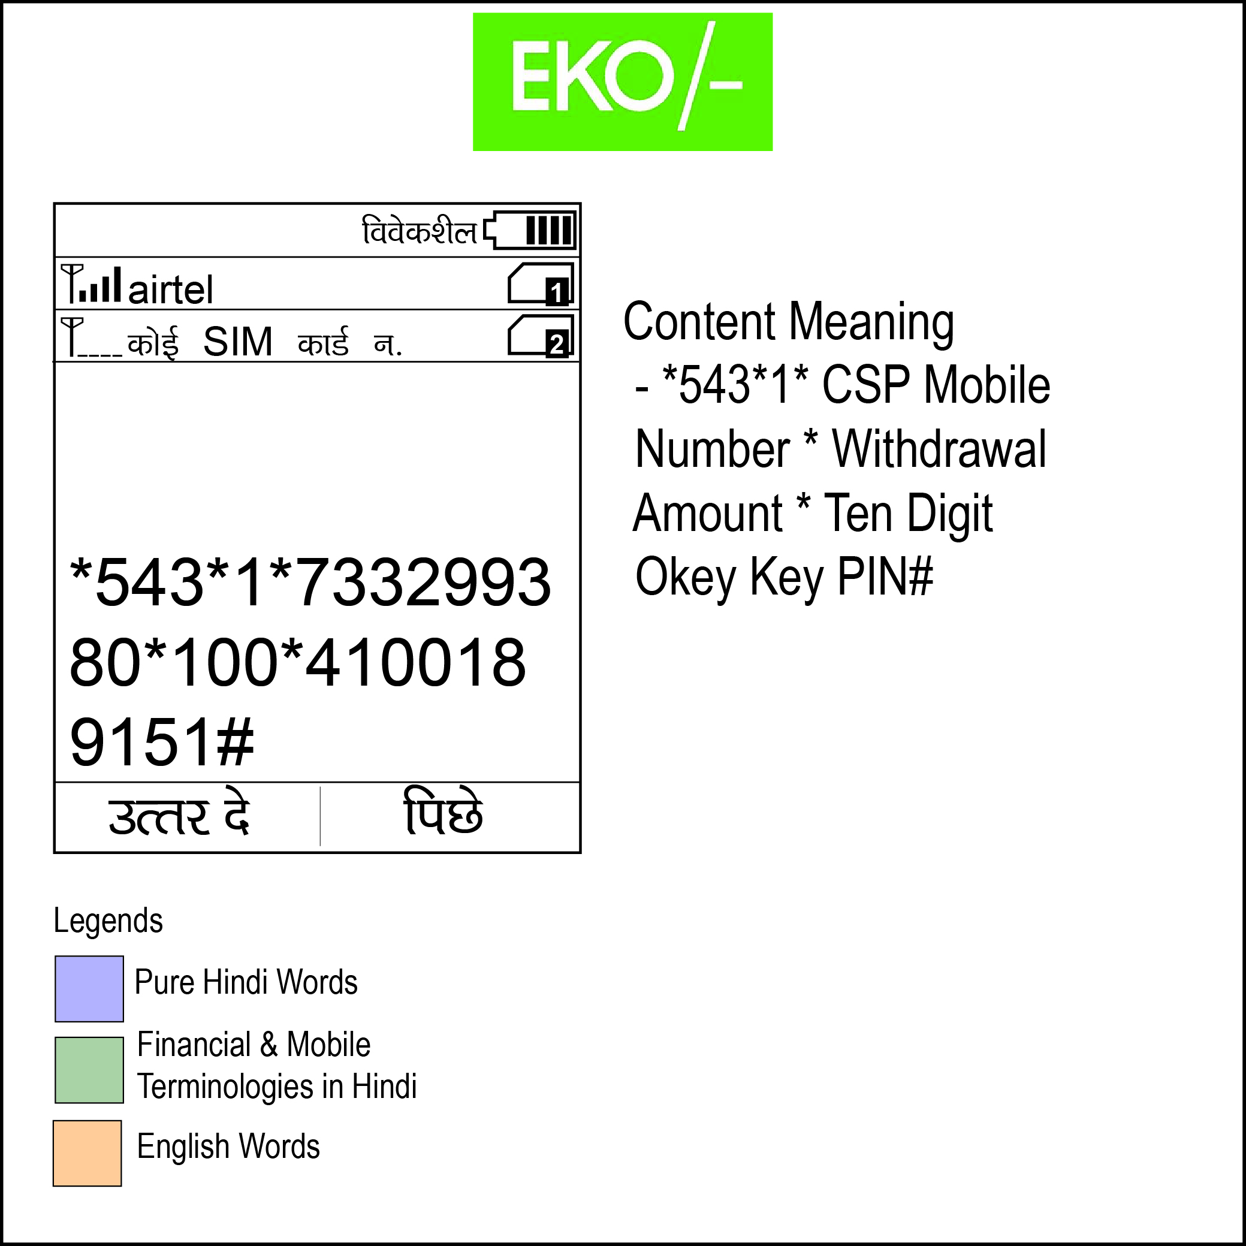
4. Usage
Syntax
The sequence of numbers and symbols required to use MFS is difficult to enter. This syntax requirement causes confusion.
Hash: Many women in our study pressed * instead of # in all three services.
Key correlations: While using Airtel Money and Vodafone M-Pesa, our participants were not able to correlate “answer,” “send,” and “back” with their associated soft key and press the call connect button below it.
PIN: With Eko, the cash withdrawal feature involves creating a PIN before dialing the syntax. None of our participants understood how to create the syntax for initiating the withdrawal because they do not understand the instructions to generate this PIN.
Decimals: The Eko and Vodafone interfaces use decimals which are not well understood. This caused many of our participants to read balance amounts incorrectly.

Slide 24
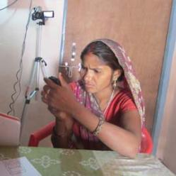
4. Usage
Features
Out of the three features (balance check, cash withdrawal, and mobile recharge), most women (all prospective MFS users) expressed interest in using the balance check feature independently because they can check it on their own at any time without asking the agent. Some women, whose family members work in the cities, also expressed interest in using the cash withdrawal feature of the EKO technology. Neither of these features would be used frequently as women only check their balance when they deposit or withdraw cash (approximately once every two months).

Slide 25
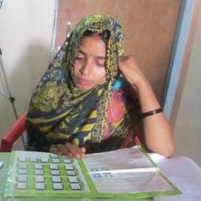
4. Usage
Assisted Transactions
Low comfort with mobile phones and mobile financial services is a huge barrier to independent usage among women. Additionally, most women stay at home and have their husbands and children transact for them.
A majority of the women in our study cannot use these mobile financial services independently or need assistance while using them. Educated participants needed one-time assistance as compared to lesser educated women, who need assistance 2-3 times.
Illiterate and lesser educated women are either not able to use the services at all or need more assistance in understanding the content and language.

Slide 26
Recommendations
Use Language I Know
Language in the user interfaces and service booklets should be in the customer’s local dialect.
Make It Easy To Read
The font size of the service booklet and interface should be big enough to read.
Drop The Decimals
The use of decimals in the balance amount and withdrawal amount should be avoided.
Keep It Short
The syntax used to check balance and initiate cash withdrawal should be shorter and simpler.
Require Fewer Steps
Fewer steps should be required to navigate. This will help customers more easily transact.
Come to Where I Am
All mobile financial service providers need to better target their potential and existing customers if they want to ensure wider uptake of their services among poor women.

Slide 27


Thank you.
Grameen Foundation India
Gurgaon, India
Grameen Foundation
Washington , DC
Center for Knowledge Societies
New Delhi, India

